Slide 1
Diffie-Hellman Key Exchange
Color Mixing Example
Rick Stroud
21 September 2015
CSCE 522

Slide 2
The Problem of Key Exchange
One of the main problems of symmetric key encryption is it requires a secure & reliable channel for the shared key exchange.
The Diffie-Hellman Key Exchange protocol offers a way in which a public channel can be used to create a confidential shared key.

Slide 3
Modular what?
In practice the shared encryption key relies on such complex concepts as Modular Exponentiation, Primitive Roots and Discrete Logarithm Problems.
Let’s see though is we can explain the Diffie-Hellman algorithm with no complex mathematics.

Slide 4
A Difficult One-Way Problem
The first thing we require is a simple real-world operation that is easy to Do but hard to Undo.
  You can ring a bell but not unring one.
  Toothpaste is easy to squeeze out of a tube but famously hard to put back in.
In our example we will use Mixing Colors.
  Easy to mix 2 colors, hard to unmix

Slide 5
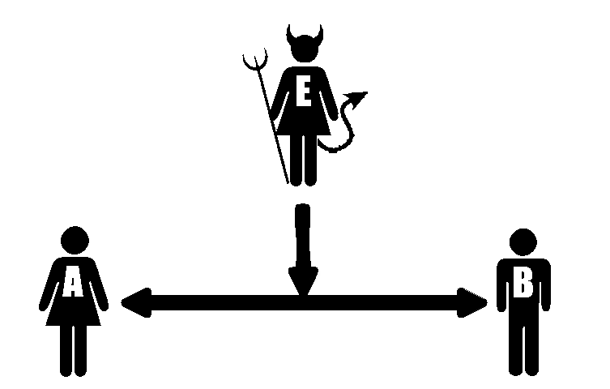
Alice & Bob with Eve listening wish to make a secret shared color

Slide 6
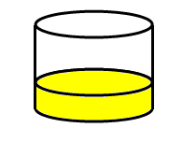
Step 1 - Both publicly agree to a shared color
Notes:
In step 1 Alice & Bob publicly agree on a shared color.
Notice as this is public that Eve is privy to the information as well.
In our example we will select Yellow as the shared color.

Slide 7
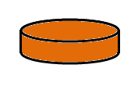

Step 2 - Each picks a secret color
Notes:
In step 2 each Alice & Bob select a secret color.
Neither knows of the other’s secret color as it is not shared.
Because they are not shared Eve has no opportunity to learn either’s secret color.
In our example Alice selects Orange for her secret color & Bob selects Teal for his secret color.

Slide 8
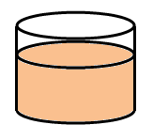


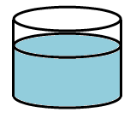
Step 3 - Each adds their secret color to the shared color
Notes:
In step 3 each takes their secret color and mixes it with the shared color.
In our example, to the shared Yellow:
Alice mixes her secret Orange to produce a Peach
Bob mixes his secret Teal to produce a Light blue

Slide 9
Step 4 - Each sends the other their new mixed color
Notes:
In step 4 each shares their mixture with the other.
Notice because the channel for sharing is not secure that Eve now knows the mixtures of each Alice & Bob.
Eve also knows the previously shared component of each mixture, Yellow, but not the secret color added by each.

Slide 10
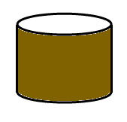


Each combines the shared color from the other with their own secret color
Notes:
And finally in step 5 the magic happens.
Each Alice & Bob combine the mixture received from the other with their own secret color.
This produces a new and identical mixture for each.
Notice without access to the secret color of either Alice or Bob that Eve is unable to perform this step.

Slide 11
Alice & Bob have agreed to a shared color unknown to Eve
How is it that Alice & Bob’s final mixtures are identical?
Alice mixed
  [(Yellow + Teal) from Bob] + Orange
Bob mixed
  [(Yellow + Orange) from Alice] + Teal
Notes:
Alice & Bob only performed the easy & trivial task of mixing colors.
Eve has no knowledge of the secret colors used by each Alice & Bob.
Eve is left with the difficult problem of unmixing colors.

Slide 12
Alice & Bob have agreed to a shared color unknown to Eve
How is it that Alice & Bob’s final mixture is secret?
Eve never has knowledge of the secret colors of either Alice or Bob
Unmixing a color into its component colors is a hard problem

Slide 13
Alice & Bob have agreed to a shared color unknown to Eve
How is it that Alice & Bob’s final mixture is secret?
Eve never has knowledge of the secret colors of either Alice or Bob
Unmixing a color into its component colors is a hard problem

Slide 14
Diffie-Hellman Key Exchange
Adding Mathematics
Rick Stroud
21 September 2015
CSCE 522

Slide 15
Let’s get back to math
We will rely on the formula below being an easy problem one direction and hard in reverse.
s = g^{n} mod p
  Easy: given g, n, & p, solve for s
  Hard: given s, g, & p, solve for n
And the property of
  g^{a*b} mod p = g^{b*a} mod p

Slide 16
Step 1 –Publicly shared information
Alice & Bob publicly agree to a large prime number called the modulus, or p.
Alice & Bob publicly agree to a number called the generator, or g, which has a primitive root relationship with p.
In our example we’ll assume
  p = 17
  g = 3
Eve is aware of the values of p or g.

Slide 17
Step 2 – Select a secret key
Alice selects a secret key, which we will call a.
Bob selects a secret key, which we will call b.
For our example assume:
  a = 54
  b = 24
Eve is unaware of the values of a or b.

Slide 18
Step 3 – Combine secret keys with public information
Alice combines her secret key of a with the public information to compute A.
  A = gª mod p
  A = 3⁵⁴ mod 17
  A = 15

Slide 19
Step 3 – Combine secret key with public information
Bob combines his secret key of b with the public information to compute B.
  B = g^{b} mod p
  B = 3⁵⁴ mod 17
  B = 16

Slide 20
Step 4 – Share combined values
Alice shares her combined value, A, with Bob. Bob shares his combined value, B, with Alice.
Sent to Bob
  A = 15
Sent to Alice
  B = 16
Eve is privy to this exchange and knows the values of A and B

Slide 21
Step 5 – Compute Shared Key
Alice computes the shared key.
  s = (B mod p)ª mod p
  s = g^{b*a} mod p
  s = 3^{54*24} mod 17
  s = 1
Bob computes the shared key.
  s = (A mod p)ª mod p
  s = g^{a*b} mod p
  s = 3^{24*54} mod 17
  s = 1

Slide 22
Alice & Bob have a shared encryption key, unknown to Eve
Alice & Bob have created a shared secret key, s, unknown to Eve
In our example s=1
The shared secret key can now be used to encrypt & decrypt messages by both parties.
See the Youtube video on this example at:
https://www.youtube.com/watch?v=3QnD2c4Xovk

